Slide 1

Activity Points System
Software Design Document
Niyoosha Ziad - 53
Manudev B S - 73
Arjun P R - 75
Arun M - 76

Slide 2
Introduction
The Activity Points Management System is designed to streamline and enhance the process of tracking student achievements and certificate validation. By digitizing the management of activity points, the system ensures transparency, security, and efficiency for all users.
2

Slide 3
System Architecture
Frontend Layer
Backend Layer
Database (FireStore)
3

Slide 4
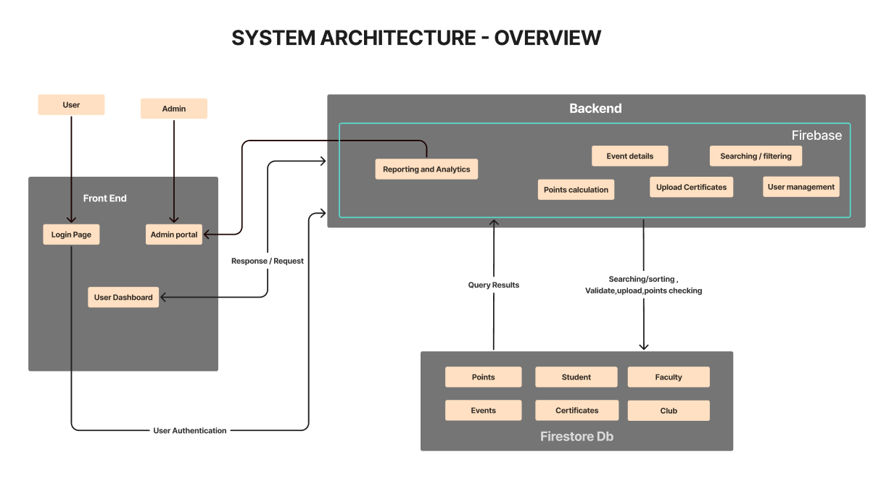
4

Slide 5
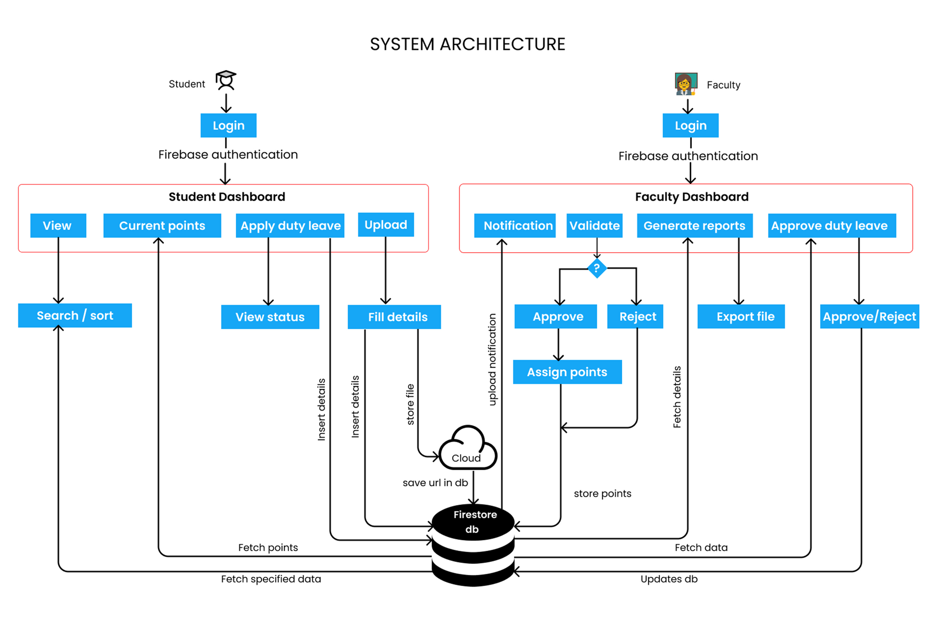
5

Slide 6
Modules
Authentication & User Management Module
Student Module
Verification Module (Faculty Interface)
Admin Control Module
Data Analytics & Reporting Module
Notification & Alerts Module
6

Slide 7
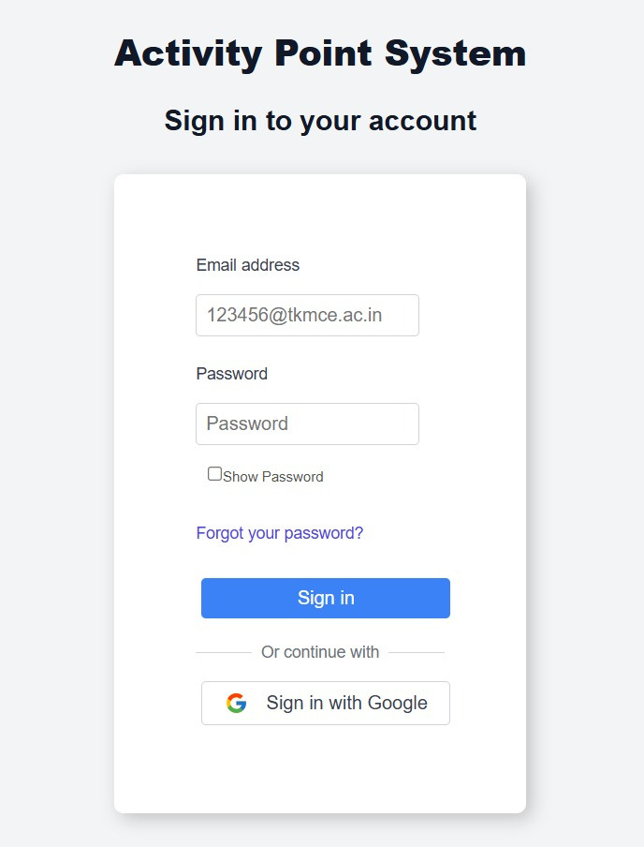
GUI design
Login
7

Slide 8
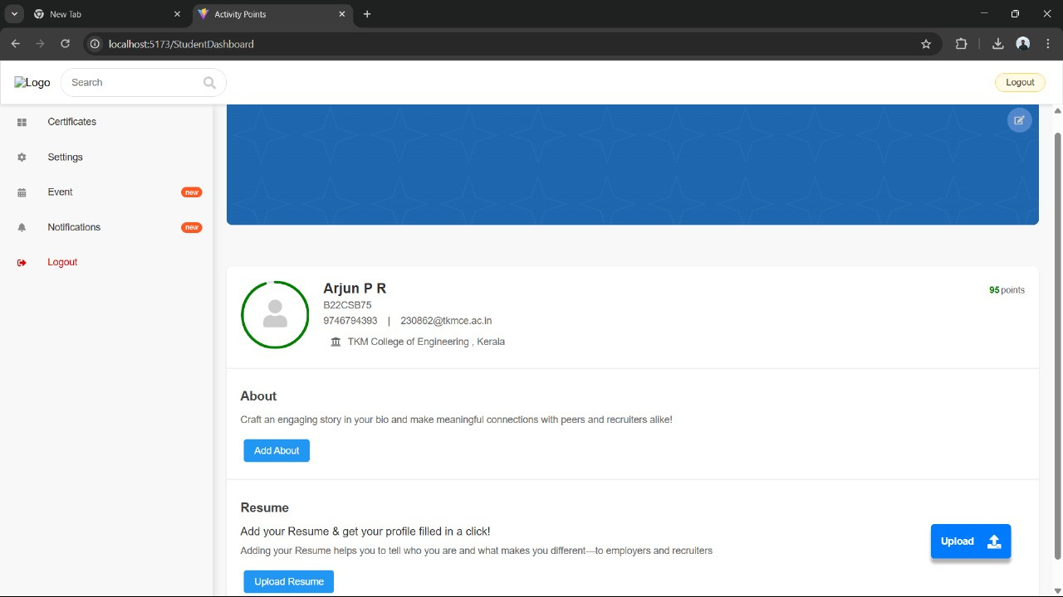
GUI design
Student Dashboard
8

Slide 9
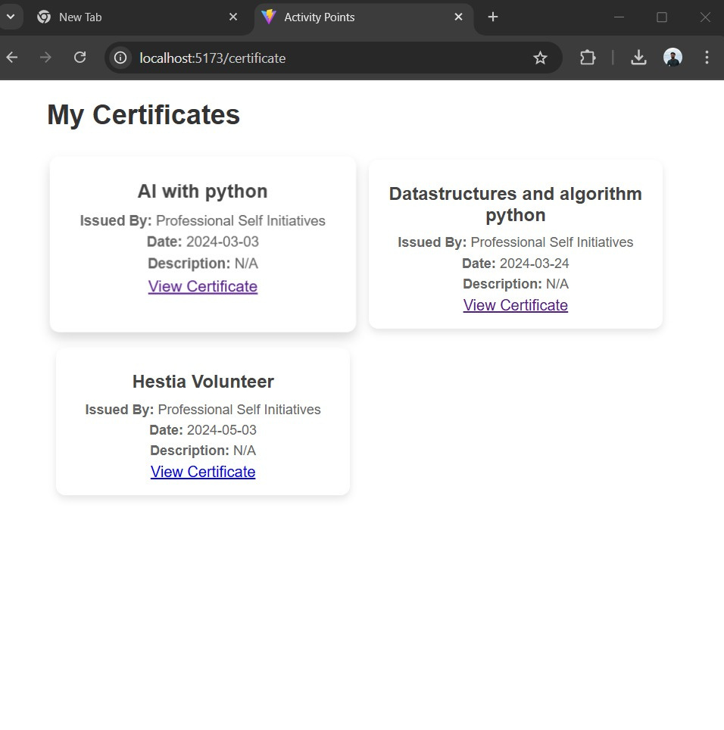
GUI design
Certificates
9

Slide 10
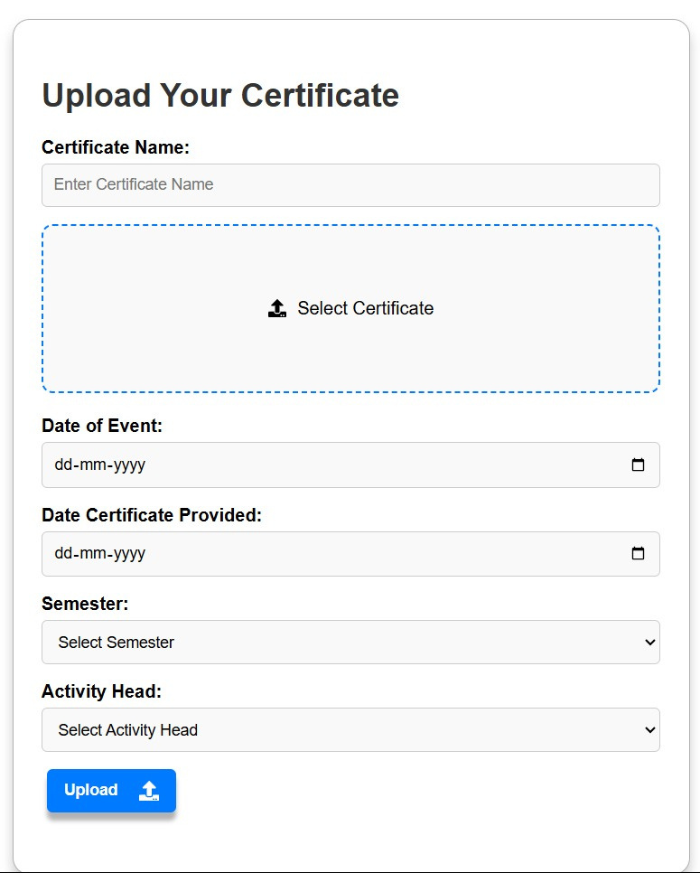
GUI design
Upload
10

Slide 11
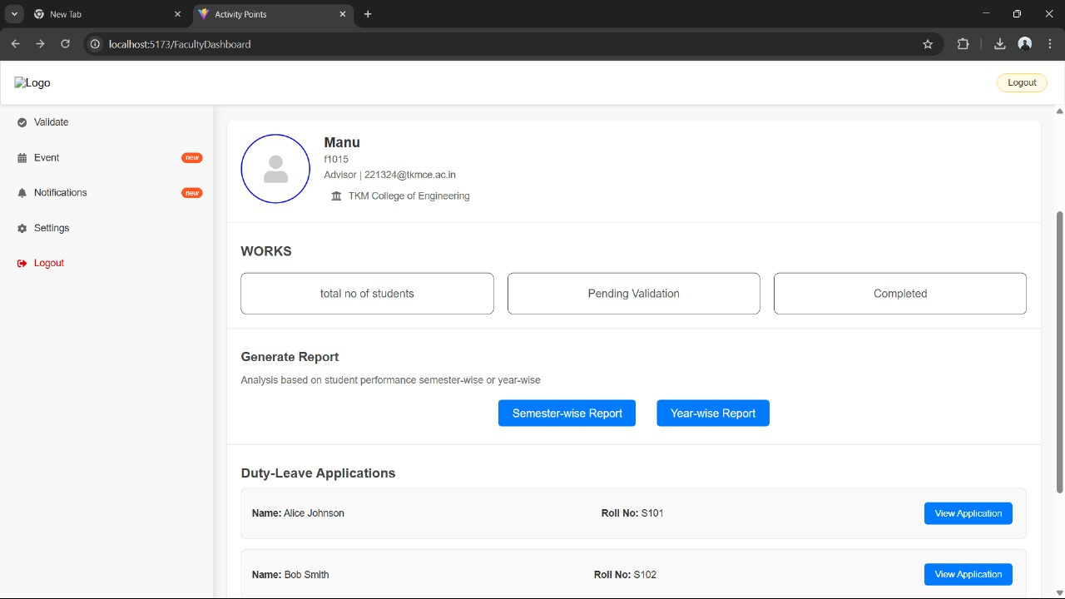
GUI design
Faculty
11

Slide 12
API design
Interacting with database: it inserts, retrieves and updates the details of students, certificates, events etc.
Uploading Certificates: Upon certificate submission, the API handles the file upload, stores metadata such as activity type, event date, and semester, and saves the file to the cloud storage
Downloading Certificates as PDF: the selected certificates are merged and converted into single downloadable pdf .
12

Slide 13
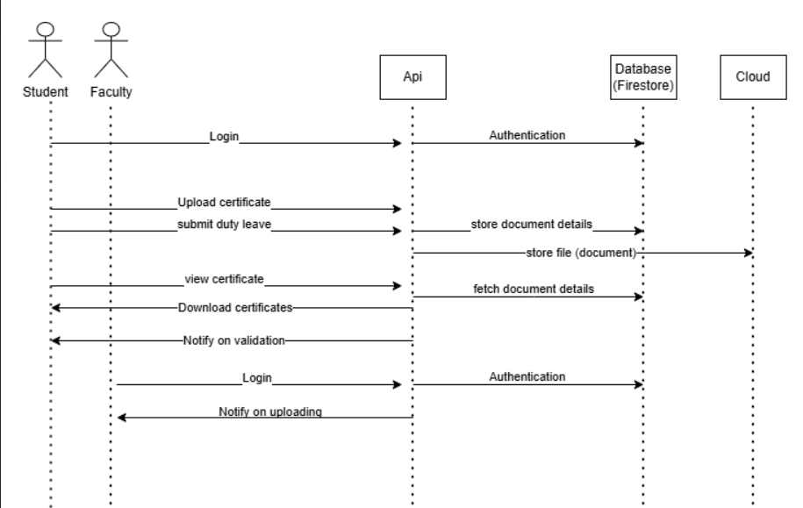
API Design
13

Slide 14
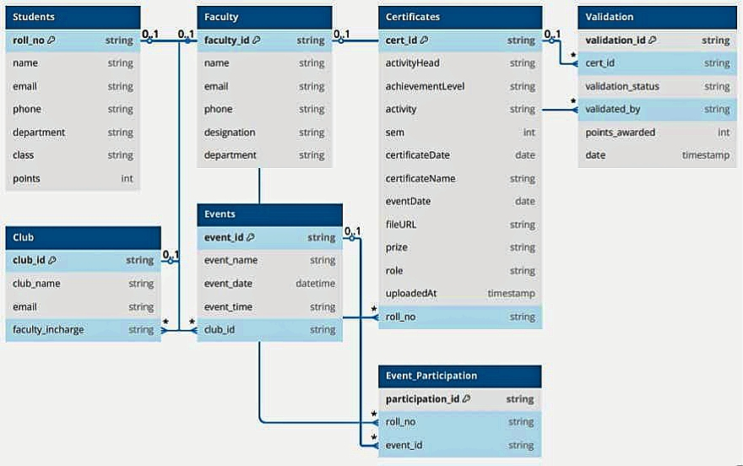
Database Design
14

Slide 15
Technology stack
Frontend
React with Tailwindcss
Javascript
Backend
Firebase
Javascript
Database
Firestore
Cloud
Firebase storage
Deployement & hosting
Firebase
15

Slide 16
Testing
Frontend testing
Jest: Testing framework for JS
React Testing Library: For component testing with focus on behavior
Cypress or Playwright: For end-to-end (E2E) testing
Firebase Testing
Firebase Emulator Suite for local testing
Unit testing service functions (e.g., fetchUserData, addCertificate)
Mock Firebase services using libraries like:
firebase-mock
Integration Testing
Combines frontend + backend:
Use Cypress or Playwright to simulate full flows (e.g., user logs in → uploads certificate → data appears in dashboard)
16

Slide 17
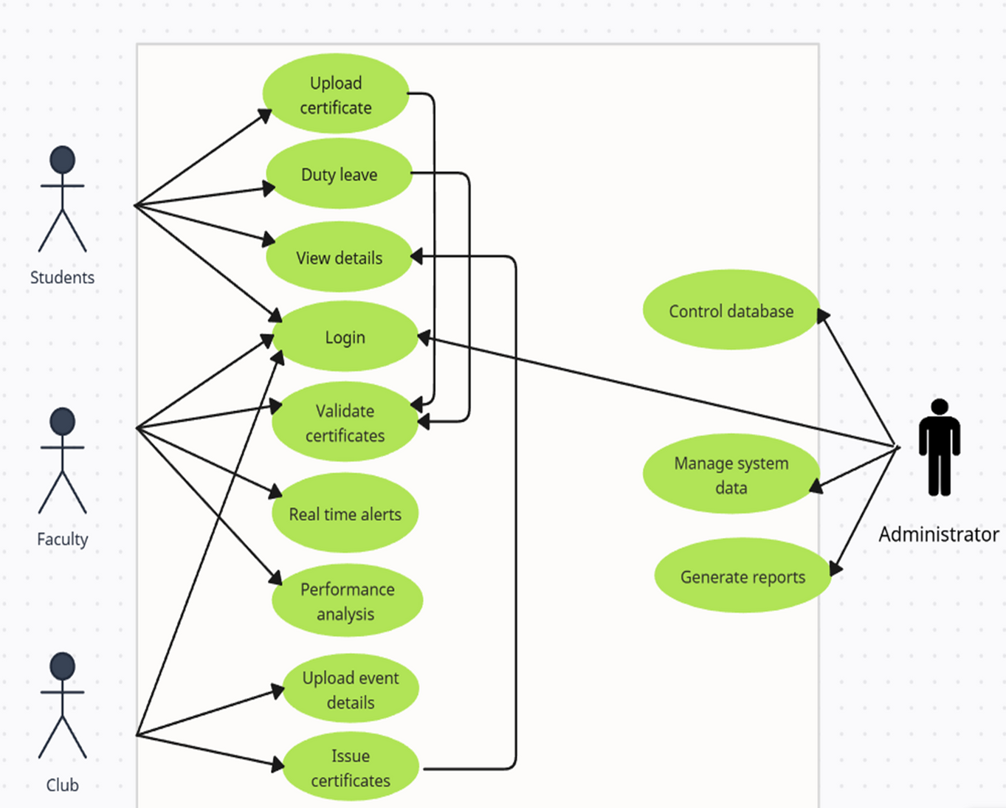
Use case Diagram
17

Slide 18
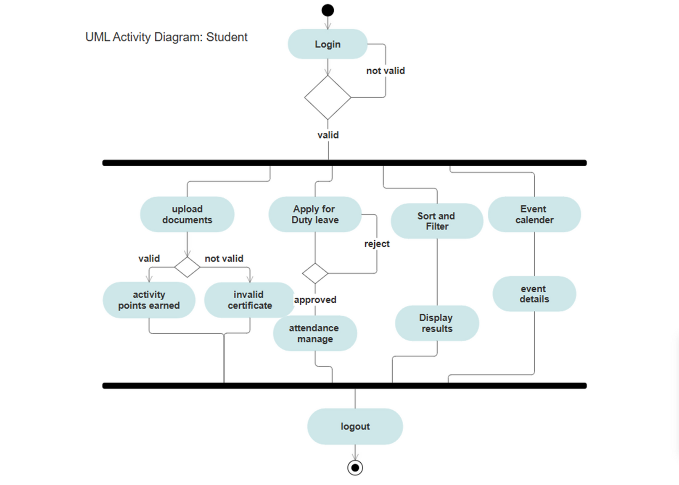
18

Slide 19
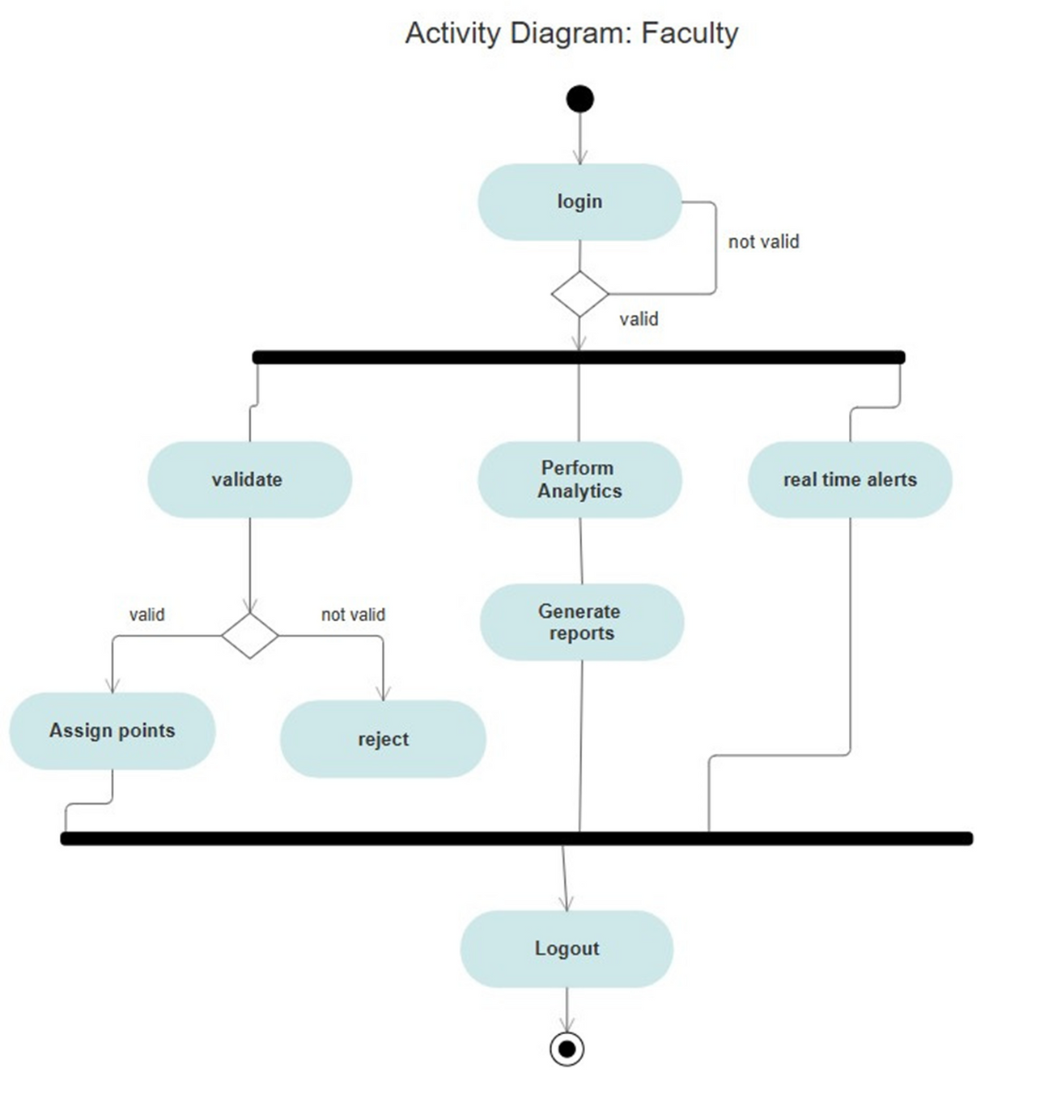
19

Slide 20
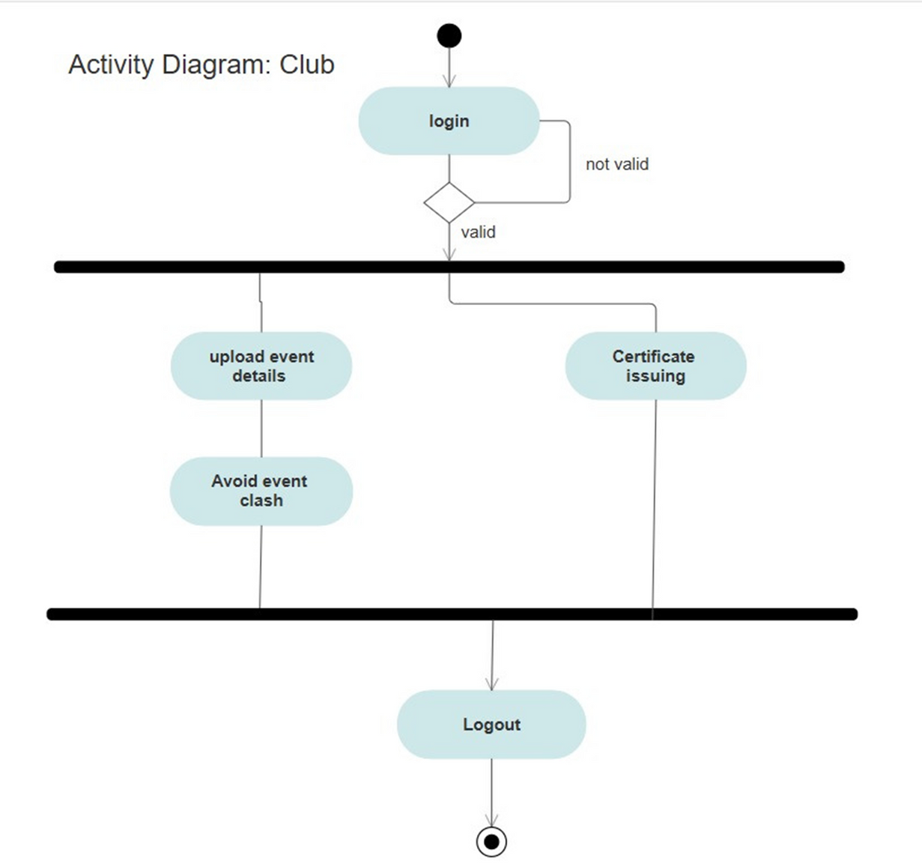
20

Slide 21
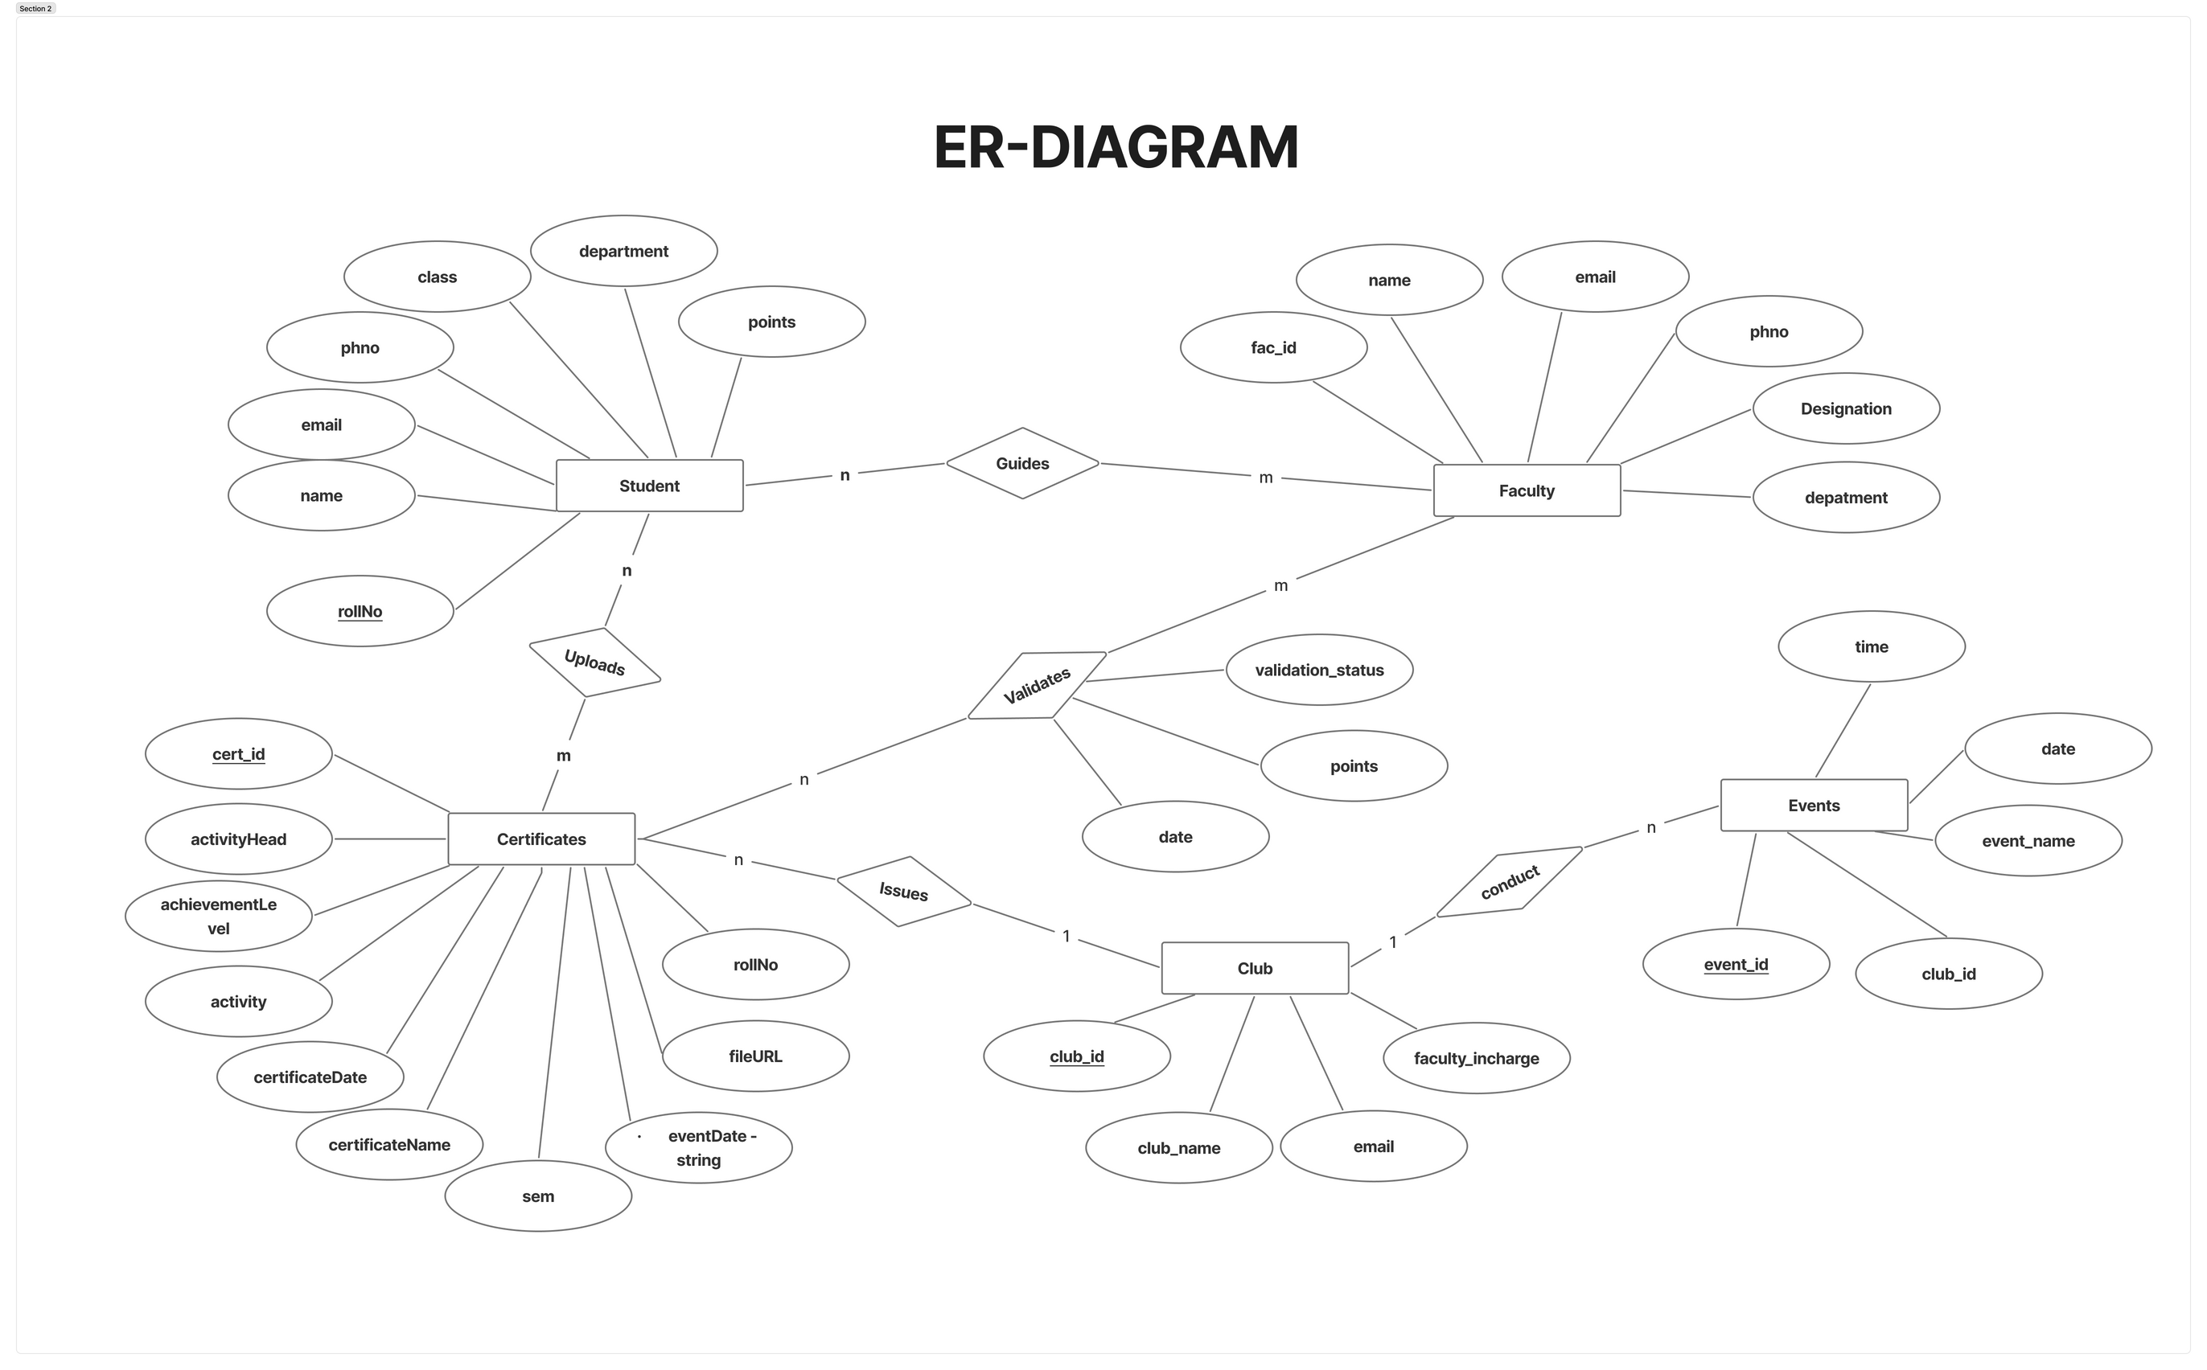

Slide 22
Thank you

